Slide 1
CST 205 OOP :Core Java Fundamentals

Slide 2
SYLLABUS
Primitive Data types - Integers, Floating Point Types, Characters, Boolean. Literals, Type Conversion and Casting, Variables, Arrays, Strings, Vector class.
Operators - Arithmetic Operators, Bitwise Operators, Relational Operators, Boolean Logical Operators, Assignment Operator, Conditional (Ternary) Operator, Operator Precedence.
Control Statements - Selection Statements, Iteration Statements and Jump Statements
Object Oriented Programming in Java - Class Fundamentals, Declaring Objects, Object Reference, Introduction to Methods, Constructors, this Keyword, Method Overloading, Using Objects as Parameters, Returning Objects, Recursion, Access Control, Static Members, Final Variables, Inner Classes, Command Line Arguments, Variable Length Arguments.
Inheritance - Super Class, Sub Class, The Keyword super, protected Members, Calling Order of Constructors, Method Overriding, the Object class, Abstract Classes and Methods, using final with Inheritance.

Slide 3
OBJECTIVES
Method Overloading
Using Objects as Parameters
Returning Objects
Recursion
Access Control
Static Members
Final Variables
Inner Classes
Command Line Arguments
Variable Length Arguments.

Slide 4
Method overloading
In Java it is possible to define two or more methods within the same class that share the same name, as long as their parameter declarations are different.
Method overloading is one of the ways that Java supports polymorphism.
Overloaded methods must differ in the type and/or number of their parameters
When an overloaded method is invoked, Java uses the type and/or number of arguments as its guide to determine which version of the overloaded method to actually call.
When Java encounters a call to an overloaded method, it simply executes the version of the method whose parameters match the arguments used in the call.

Slide 5
Method overloading
// Demonstrate method overloading.
class OverloadDemo {
void test() {
System.out.println("No parameters");
}
// Overload test for one integer parameter.
void test(int a) {
System.out.println("a: " + a);
}
// Overload test for two integer parameters.
void test(int a, int b) {
System.out.println("a and b: " + a + " " + b);}

Slide 6
Method overloading
// overload test for a double parameter double test(double a) { System.out.println("double a: " + a); return a*a; } } class Overload { public static void main(String args[]) { OverloadDemo ob = new OverloadDemo(); double result; | // call all versions of test() ob.test(); ob.test(10); ob.test(10, 20); result = ob.test(123.25); System.out.println("Result of ob.test(123.25): " + result); }} This program generates the following output: No parameters a: 10 a and b: 10 20 double a: 123.25 Result of ob.test(123.25): 15190.5625

Slide 7
Method overloading
test( ) is overloaded four times. The first version takes no parameters,
the second takes one integer parameter, the third takes two integer parameters, and the fourth takes one double parameter.
The fact that the fourth version of test( ) also returns a value is of no consequence relative to overloading, since return types do not play a role in overload resolution.
When an overloaded method is called, Java looks for a match between the arguments used to call the method and the method’s parameters.

Slide 8
Automatic type conversions apply to overloading.
class OverloadDemo { void test() { System.out.println("No parameters"); } // Overload test for two integer parameters. void test(int a, int b) { System.out.println("a and b: " + a + " " + b);} void test(double a) { System.out.println("Inside test(double) a: " + a); }} | class Overload { public static void main(String args[]) { OverloadDemo ob = new OverloadDemo(); int i = 88; ob.test(); ob.test(10, 20); ob.test(i); // this will invoke test(double) ob.test(123.2); // this will invoke test(double) }} This program generates the following output: No parameters a and b: 10 20 Inside test(double) a: 88 Inside test(double) a: 123.2

Slide 9
Automatic type conversions apply to overloading.
As you can see, this version of OverloadDemo does not define test(int).
Therefore, when test( ) is called with an integer argument inside Overload, no matching method is found.
However, Java can automatically convert an integer into a double, and this conversion can be used to resolve the call.
Therefore, after test(int) is not found, Java elevates i to double and then calls test(double). Of course, if test(int) had been defined, it would have been called instead.
Java will employ its automatic type conversions only if no exact match is found.

Slide 10
Overloading constructors
class Box { double width; double height; double depth; // constructor used when all dimensions specified Box(double w, double h, double d) { width = w; height = h; depth = d; } // constructor used when no dimensions specified Box() { width = -1; // use -1 to indicate height = -1; // an uninitialized depth = -1; // box } | // constructor used when cube is created Box(double len) { width = height = depth = len; } // compute and return volume double volume() { return width * height * depth; } } class OverloadCons { public static void main(String args[]) { // create boxes using the various constructors Box mybox1 = new Box(10, 20, 15); Box mybox2 = new Box(); Box mycube = new Box(7); double vol;

Slide 11
Overloading constructors
// get volume of first box
vol = mybox1.volume();
System.out.println("Volume of mybox1 is " + vol);
// get volume of second box
vol = mybox2.volume();
System.out.println("Volume of mybox2 is " + vol);
// get volume of cube
vol = mycube.volume();
System.out.println("Volume of mycube is " + vol);
}}
The output produced by this program is shown here:
Volume of mybox1 is 3000.0
Volume of mybox2 is -1.0
Volume of mycube is 343.0

Slide 12
Using Objects as Parameters
// Objects may be passed to methods. class Test { int a, b; Test(int i, int j) { a = i; b = j; } // return true if o is equal to the invoking object boolean equals(Test o) { if(o.a == a && o.b == b) return true; //ob2.a== ob1.a else return false; } } | class PassOb { public static void main(String args[]) { Test ob1 = new Test(100, 22); Test ob2 = new Test(100, 22); Test ob3 = new Test(-1, -1); System.out.println("ob1 == ob2: " + ob1.equals(ob2)); System.out.println("ob1 == ob3: " + ob1.equals(ob3)); }} This program generates the following output: ob1 == ob2: true ob1 == ob3: false

Slide 13
Allows one object to initialize another.
class Box { double width; double height; double depth; // Notice this constructor. It takes an object of type Box. Box(Box ob) { // pass object to constructor width = ob.width; height = ob.height; depth = ob.depth; } // constructor used when all dimensions specified Box(double w, double h, double d) { width = w; height = h; depth = d; } | // constructor used when no dimensions specified Box() { width = -1; // use -1 to indicate height = -1; // an uninitialized depth = -1; // box } // constructor used when cube is created Box(double len) { width = height = depth = len; } // compute and return volume double volume() { return width * height * depth; } }

Slide 14
allows one object to initialize another.
class OverloadCons2 { public static void main(String args[]) { // create boxes using the various constructors Box mybox1 = new Box(10, 20, 15); Box mybox2 = new Box(); Box mycube = new Box(7); Box myclone = new Box(mybox1); // create copy of mybox1 double vol; // get volume of first box vol = mybox1.volume(); System.out.println("Volume of mybox1 is " + vol); | // get volume of second box vol = mybox2.volume(); System.out.println("Volume of mybox2 is " + vol); // get volume of cube vol = mycube.volume(); System.out.println("Volume of cube is " + vol); // get volume of clone vol = myclone.volume(); System.out.println("Volume of clone is " + vol); } }

Slide 15
Argument Passing
Call-by-value.
This approach copies the value of an argument into the formal parameter of the subroutine. Therefore, changes made to the parameter of the subroutine have no effect on the argument.
In Java, when you pass a primitive type to a method, it is passed by value.
Call-by-reference.
In this approach, a reference to an argument (not the value of the argument) is passed to the parameter.
Inside the subroutine, this reference is used to access the actual argument specified in the call. This means that changes made to the parameter will affect the argument used to call the subroutine.
Objects are passed to methods by use of call-by-reference. Changes to the object inside the method do affect the object used as an argument.

Slide 16

Argument Passing :Call by Value
class Test {
void meth(int i, int j) {
i *= 2;//i= i*2;
j /= 2;//j=j/2;
}}
class CallByValue {
public static void main(String args[]) {
Test ob = new Test();
int a = 15, b = 20;
System.out.println("a and b before call: " +a + " " + b);
ob.meth(a, b);
System.out.println("a and b after call: " +a + " " + b);
}}

Slide 17
Argument Passing –Call By Reference
// Objects are passed by reference. class Test { int a, b; Test(int i, int j) { a = i; b = j; } // pass an object void meth(Test o) { o.a *= 2;//o.a = o.a*2 o.b /= 2;//o.b = o.b/2 } } | class CallByRef { public static void main(String args[]) { Test ob = new Test(15, 20); System.out.println("ob.a and ob.b before call: " + ob.a + " " + ob.b); ob.meth(ob); System.out.println("ob.a and ob.b after call: " +ob.a + " " + ob.b); } } This program generates the following output: ob.a and ob.b before call: 15 20 ob.a and ob.b after call: 30 10

Slide 18
Recursion
Recursion is the process of defining something in terms of itself.
As it relates to Java programming, recursion is the attribute that allows a method to call itself.
A method that calls itself is said to be recursive.
The classic example of recursion is the computation of the factorial of a number.
The factorial of a number N is the product of all the whole numbers between 1 and N. For example, 3 factorial is 1 × 2 × 3, or 6.

Slide 19
Recursion
// A simple example of recursion.
class Factorial {
// this is a recursive method
int fact(int n) {
int result;
if(n==1) return 1;
result = fact(n-1) * n;
return result;

Slide 20
Recursion
}
}
class Recursion {
public static void main(String args[]) {
Factorial f = new Factorial();
System.out.println("Factorial of 3 is " + f.fact(3));
System.out.println("Factorial of 4 is " + f.fact(4));
System.out.println("Factorial of 5 is " + f.fact(5));
}
}

Slide 21
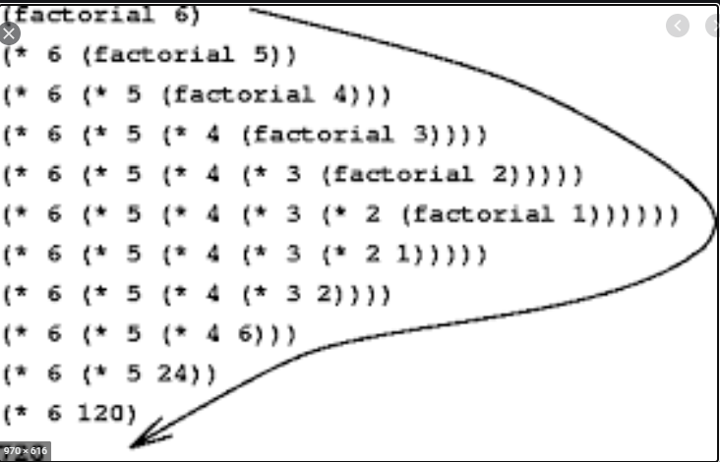
Recursion

Slide 22
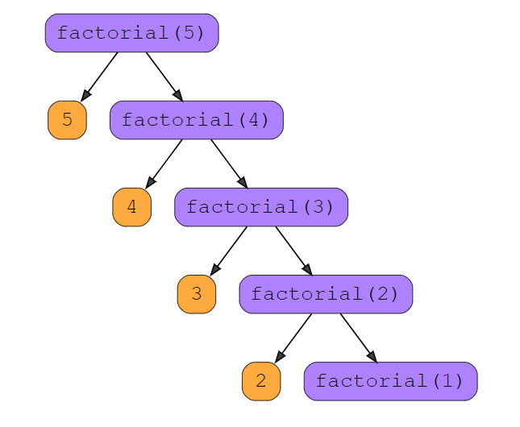
Recursion : \https://www.educative.io/courses/recursion-for-coding-interviews-in-python/B8wMXy0nmvk

Slide 23
Introducing Access Control
Encapsulation links data with the code that manipulates it. However,encapsulation provides another important attribute: access control.
Through encapsulation, you can control what parts of a program can access the members of a class.
By controlling access, you can prevent misuse. For example, allowing access to data only through a well defined set of methods, you can prevent the misuse of that data. Thus, when correctly implemented, a class creates a “black box” which may be used, but the inner workings of which are not open to tampering.
A member can be accessed is determined by the access specifier that modifies its
declaration.
Java’s access specifiers are public, private, and protected. Java also defines a default access level. protected applies only when inheritance is involved.

Slide 24
Introducing Access Control
When a member of a class is modified by the public specifier, then that member can be accessed by any other code.
When a member of a class is specified as private, then that member can only be accessed by other members of its class.
Now you can understand why main( ) has always been preceded by the public
specifier. It is called by code that is outside the program—that is, by the Java run- time system.
When no access specifier is used, then by default the member of a class is public within its own package, but cannot be accessed outside of its package.
public int i;
private double j;
private int myMethod(int a, char b) { // ...

Slide 25
Introducing Access Control
class Test { int a; // default access public int b; // public access private int c; // private access // methods to access c void setc(int i) { // set c's value c = i; } int getc() { // get c's value return c; } } class AccessTest { public static void main(String args[]) { Test ob = new Test(); | // These are OK, a and b may be accessed directly ob.a = 10; ob.b = 20; // This is not OK and will cause an error // ob.c = 100; // Error! // You must access c through its methods ob.setc(100); // OK System.out.println("a, b, and c: " + ob.a + " " + ob.b + " " + ob.getc()); } }

Slide 26
Introducing Access Control
Inside the Test class, a uses default access, which for this example is the same as specifying public.
b is explicitly specified as public. Member c is given private access.
This means that it cannot be accessed by code outside of its class.
So, inside the AccessTest class, c cannot be used directly. It must be accessed through its public methods:setc( ) and getc( ).

Slide 27
Understanding static
Normally, a class member must be accessed only in conjunction with an object of its class.
However, it is possible to create a member that can be used by itself, without reference to a specific instance.
To create such a member, precede its declaration with the keyword static.
When a member is declared static, it can be accessed before any objects of its class are created, and without reference to any object.
You can declare both methods and variables to be static.
The most common example of a static member is main( ).
main( ) is declared as static because it must be called before any objects exist.
A static variable is common to all the instances (or objects) of the class because it is a class level variable.

Slide 28
Understanding static
Instance variables declared as static are, essentially, global variables.
When objects of its class are declared, no copy of a static variable is made.
Instead, all instances of the class share the same static variable.
Static variables are also known as Class Variables.
Static variable initialization
Static variables are initialized when class is loaded.
Static variables are initialized before any object of that class is created.
Static variables are initialized before any static method of the class executes.

Slide 29
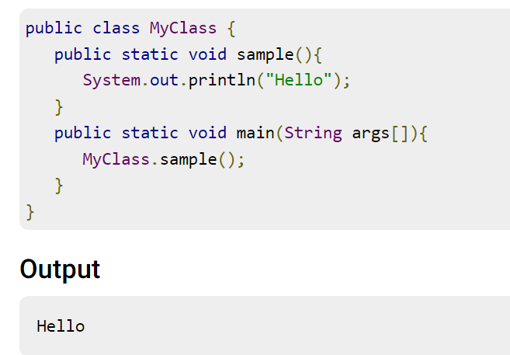
Sample Program

Slide 30
Understanding static
class Student{ int rollno; String name; String college="ITS"; } Here, "college" refers to the common property of all objects. If we make it static, this field will get the memory only once. | //Java Program to demonstrate the use of static variable class Student{ int rollno;//instance variable String name; static String college ="ITS";//static variable //constructor Student(int r, String n) { rollno = r; name = n; } }

Slide 31
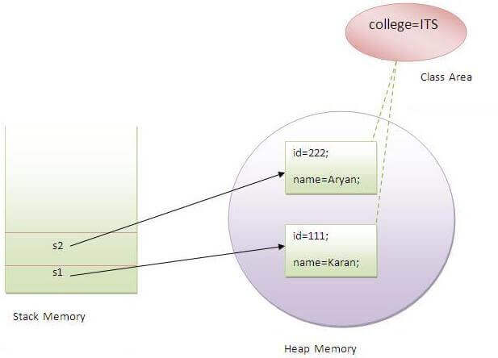
Understanding static

Slide 32
Understanding static
// Demonstrate static variables, methods, and blocks. class UseStatic { static int a = 3; static int b; static void meth(int x) { System.out.println("x = " + x); System.out.println("a = " + a); System.out.println("b = " + b); } static { System.out.println("Static block initialized."); | b = a * 4; } public static void main(String args[]) { meth(42); } } Here is the output of the program: Static block initialized. x = 42 a = 3 b = 12

Slide 33
Understanding static
UseStatic class is loaded, all of the static statements are run.
First, a is set to 3, then the static block executes, which prints a message and then initializes b to a * 4 or 12.
Then main( ) is called, which calls meth( ), passing 42 to x.
To call a static method from outside its class, you can do so using the following general form:
classname.method( )
class StaticDemo {
static int a = 42;
static int b = 99;
static void callme() {
System.out.println("a = " + a);
}

Slide 34
Understanding static
}
class StaticByName
{
public static void main(String args[]) {
StaticDemo.callme();
System.out.println("b = " + StaticDemo.b);
}
}

Slide 35
Introducing final
A variable can be declared as final. Doing so prevents its contents from being modified.This means that you must initialize a final variable when it is declared.
For example:
final int FILENEW = 1;
final int FILEOPEN = 2;
final int FILESAVE = 3;
Subsequent parts of your program can now use FILEOPEN, etc., as if they were constants, without fear that a value has been changed.

Slide 36
Introducing Nested and Inner Classes
It is possible to define a class within another class; such classes are known as nested classes.
The scope of a nested class is bounded by the scope of its enclosing class. Thus, if class B is defined within class A, then B does not exist independently of A.
A nested class has access to the members, including private members, of the class in which it is nested. However, the enclosing class does not have access to the members of the nested class.
A nested class that is declared directly within its enclosing class scope is a member of its enclosing class.
It is also possible to declare a nested class that is local to a block.

Slide 37
Introducing Nested and Inner Classes
There are two types of nested classes: static and non-static.
A static nested class is one that has the static modifier applied. It cannot refer to members of its enclosing class directly. Static nested classes are seldom used.
The most important type of nested class is the inner class. An inner class is a non-static nested class. It has access to all of the variables and methods of its outer class and may refer to them directly .
There are two types of nested classes non-static and static nested classes.The non-static nested classes are also known as inner classes.
Non-static nested class (inner class) is of 3 types
Member inner class
Anonymous inner class
Local inner class

Slide 38
Introducing Nested and Inner Classes
Java Member inner class
A non-static class that is created inside a class but outside a method is called member inner class.
// Demonstrate an inner class.
class Outer {
int outer_x = 100;
void test() {
Inner inner = new Inner();
inner.display();
}

Slide 39
Introducing Nested and Inner Classes
class Inner {
void display() {
System.out.println("display: outer_x = " + outer_x);
}}}
class InnerClassDemo {
public static void main(String args[]) {
Outer outer = new Outer();
outer.test();
}}
Output from this application is shown here:
display: outer_x = 100

Slide 40
Introducing Nested and Inner Classes
class Inner {
void display() {
System.out.println("display: outer_x = " + outer_x);
}}}
class InnerClassDemo {
public static void main(String args[]) {
Outer outer = new Outer();
outer.test();
}}
Output from this application is shown here:
display: outer_x = 100

Slide 41
Introducing Nested and Inner Classes
An inner class named Inner is defined within the scope of class Outer.
Therefore, any code in class Inner can directly access the variable outer_x.
An instance method named display( ) is defined inside Inner. This method displays outer_x on the standard output stream.
The main( ) method of InnerClassDemo creates an instance of class Outer and invokes its test( ) method.
That method creates an instance of class Inner and the display( ) method is called.
The Java compiler generates an error message if any code outside of class Outer attempts to instantiate class Inner.
We can create an instance of Inner outside of Outer by qualifying its name with Outer, as in Outer.Inner.

Slide 42
Introducing Nested and Inner Classes
Java Local inner class
A class i.e. created inside a method is called local inner class in java. If you want to invoke the methods of local inner class, you must instantiate this class inside the method.
public class localInner1{
private int data=30;//instance variable
void display(){
class Local{
void msg(){System.out.println(data);}
}
Local l=new Local();
l.msg();
}
public static void main(String args[]){
localInner1 obj=new localInner1();
obj.display();
} }

Slide 43
Introducing Nested and Inner Classes
// Define an inner class within a for loop.
class Outer {
int outerx = 100;
void test()
{
for(int i=0; i<10; i++) {
class Inner {
void display()
{

Slide 44
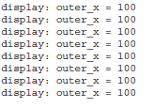
Introducing Nested and Inner Classes
System.out.println("display: outerx = " + outerx);
}}
Inner inner = new Inner();
inner.display();
}}}
class InnerClassDemo {
public static void main(String args[]) {
Outer outer = new Outer();
outer.test();
}}

Slide 45
Using Command-Line Arguments
Sometimes you will want to pass information into a program when you run it.
This is accomplished by passing command-line arguments to main( ).
A command-line argument is the information that directly follows the program’s name on the command line when it is executed.
The command-line arguments are stored as strings in a String array passed to the args parameter of main( ).
The first command-line argument is stored at args[0], the second at args[1], and so on.

Slide 46
Simple example of command-line argument in java
class CommandLineExample
{
public static void main(String args[])
{
System.out.println("Your first argument is: "+ args[0]);
}
}
javac CommandLineExample.java
java CommandLineExample test

Slide 47
Simple example of command-line argument in java
class CommandLine { public static void main(String args[]) { for(int i=0;i<args.length;i++) { System.out.println("args[" + i + "]: " +args[i]); } } } | Try executing this program, as shown here: java CommandLine this is a test 100 -1 OUTPUT args[0]: this args[1]: is args[2]: a args[3]: test args[4]: 100 args[5]: -1

Slide 48
Variable Length Arguments
Beginning with JDK 5, Java has included a feature that simplifies the creation of methods that need to take a variable number of arguments.
This feature is called varargs and it is short for variable-length arguments.
A method that takes a variable number of arguments is called a variable-arity method, or simply a varargs method.
A variable-length argument is specified by three periods (...). For example, here is how a method vaTest( ) is written using a vararg:
static void vaTest(int ... v) {

Slide 49
Old-style approach to variable-length arguments.
class PassArray { static void vaTest(int v[]) { System.out.print("Number of args: " + v.length +" Contents: "); for(int x : v) System.out.print(x + " "); System.out.println(); } public static void main(String args[]) { // Notice how an array must be created to // hold the arguments. int n1[] = { 10 }; int n2[] = { 1, 2, 3 }; | int n3[] = { }; vaTest(n1); // 1 arg vaTest(n2); // 3 args vaTest(n3); // no args } } The output from the program is shown here: Number of args: 1 Contents: 10 Number of args: 3 Contents: 1 2 3 Number of args: 0 Contents:

Slide 50
Variable-length arguments.
// Demonstrate variable-length arguments. class VarArgs { // vaTest() now uses a vararg. static void vaTest(int ... v) { System.out.print("Number of args: " + v.length + " Contents: "); for(int x : v) System.out.print(x + " "); System.out.println(); } | public static void main(String args[]) { // Notice how vaTest() can be called with a// variable number of arguments. vaTest(10); // 1 arg vaTest(1, 2, 3); // 3 args vaTest(); // no args } }

Slide 51
Variable-length arguments.
A method can have “normal” parameters along with a variable-length parameter. However,the variable-length parameter must be the last parameter declared by the method.
int doIt(int a, int b, double c, int ... vals) {
There is one more restriction to be aware of: there must be only one varargs parameter.
int doIt(int a, int b, double c, int ... vals, double ... morevals) { // Error!

Slide 52
Returning Objects
// Returning an object. class Test { int a; Test(int i) { a = i; } Test incrByTen() { Test temp = new Test(a+10); return temp; } } class RetOb { public static void main(String args[]) { | Test ob1 = new Test(2); Test ob2; ob2 = ob1.incrByTen(); System.out.println("ob1.a: " + ob1.a); System.out.println("ob2.a: " + ob2.a); ob2 = ob2.incrByTen(); System.out.println("ob2.a after second increase: “ + ob2.a); } } The output generated by this program is shown here: ob1.a: 2 ob2.a: 12 ob2.a after second increase: 22

Slide 53
Thanks!
Any questions?

